Slide 1
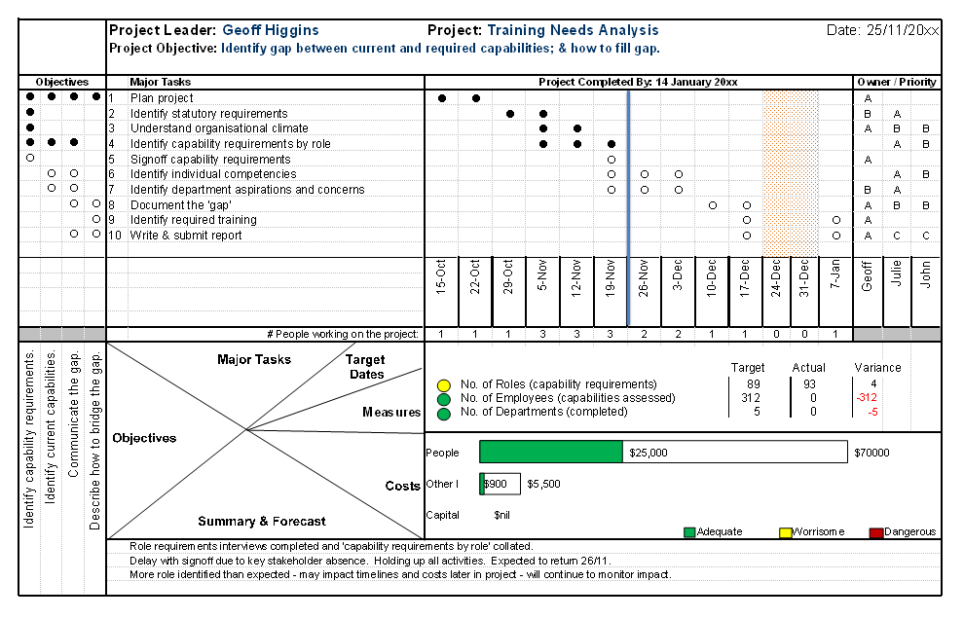

Geoff Higgins

Slide 2
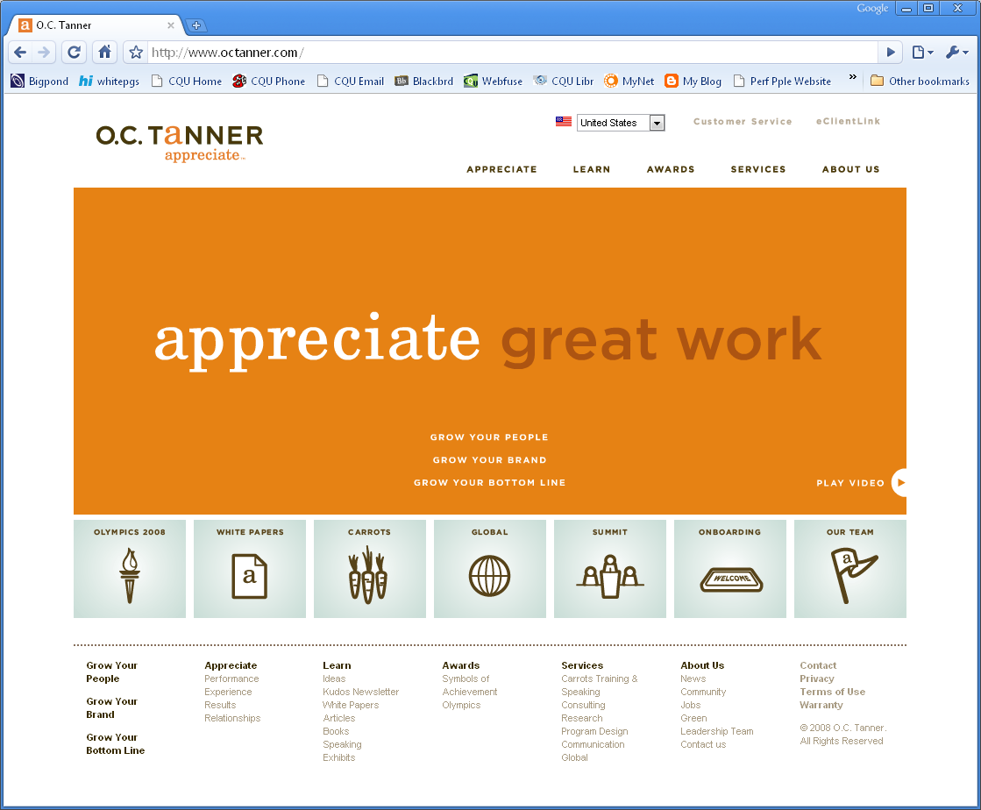
Attribution(1)
The One Page Project Manager™ is the intellectual property of O.C. Tanner Company (USA).
Image: www.octanner.com

Slide 3
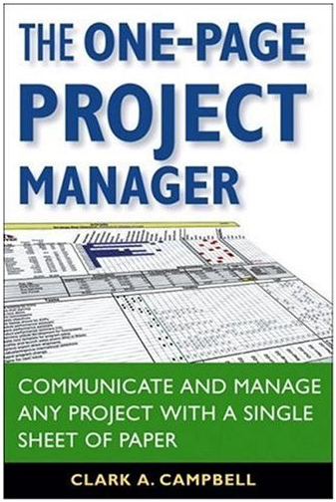
Attribution(2)
Clark Addison Campbell has published a book called The One-Page Project Manager
(2007, John Wiley & Sons).
This was a key source
of content in this presentation.
Image: www.amazon.com

Slide 4
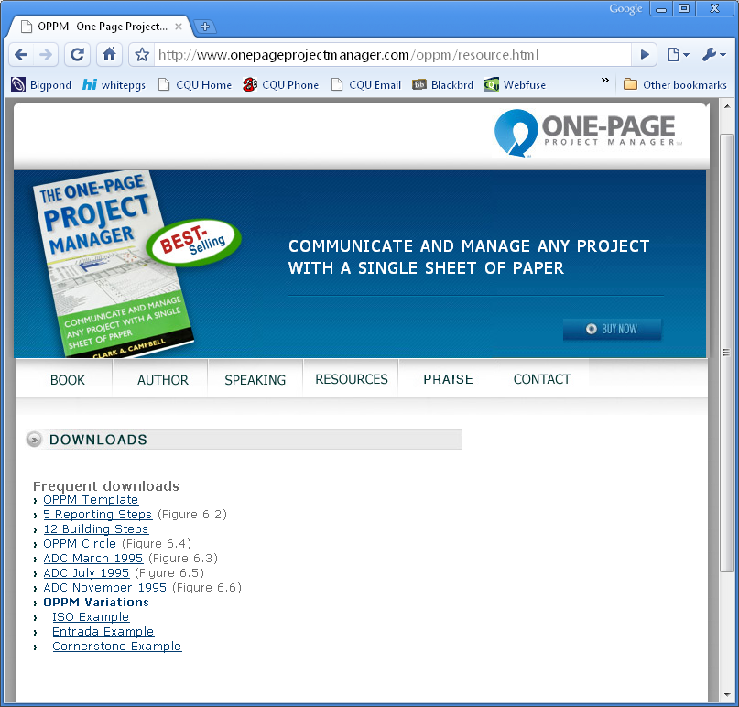
Attribution(3)
The website of the The One-Page Project Manager book includes a resources page, with examples and the OPPM Template
(for Excel).
This template was a key source of content in this presentation.
Image: www.onepageprojectmanager.com/oppm/resource.html

Slide 5
Purpose
To understand how the One Page Project Manager™ can be used as a tool for planning, monitoring and communicating project performance.
To be able to develop a One Page Project Manager™ for your own project.

Slide 6
Topics
The One Page Project Manager™
Planning
Your Own Project
Monitoring & Reporting
Reading the OPPM

Slide 7
Question
?
What is the core information that any person needs to know about your project…
  … before you start?
  … part way through?

Slide 8


Slide 9
One Page Project Manager
A tool, not a methodology
The discipline:
To present summary project information on a single A4 sheet
The purpose:
To communicate the plan & progress
Not ‘simple’, but reasonably straightforward

Slide 10
Special Note
The OPPM does not take the place of other, more detailed project documentation. Including:
Business Case
Project Schedule
Risk & Issue Register
Timesheets

Slide 11


Slide 12
General Principles
Always work on the OPPM with the team/team leaders
Get task owner agreement to commitments in the OPPM

Slide 13

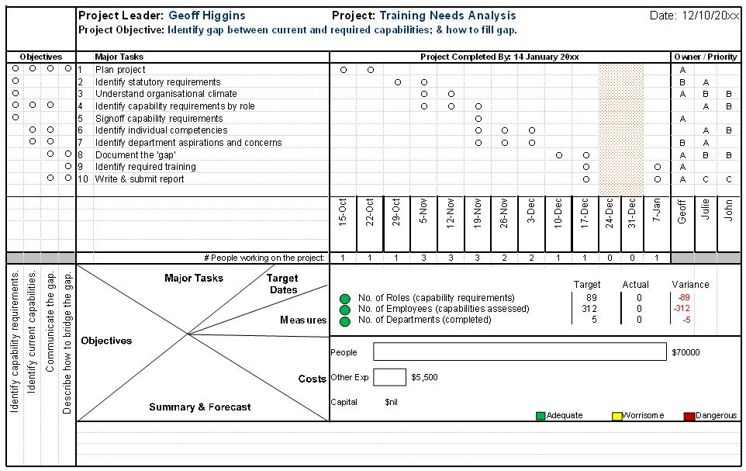











Plan
1
6
8
9
5
0. Bring the team/team leaders together.
Add header details.
Fill in task owners.
Check the ‘matrix’.
Add 3-4 sub-objectives.
Name the major project tasks.
7
2
9a
10
4
3
11
Link tasks with sub-objectives (using dots).
Create a timeline.
Link tasks with time (using dots).
Link tasks with owners (using ABC priorities).
9a. Add a ‘people count’ (optional).
Add quantitative or qualitative measures.
Add project budget.
Adapted from: Campbell 2007, ch 5

Slide 14



0. Bring the team/team leaders together.
(‘All Hands Meeting ’ c/o www.handsonusa.org )
Get the leaders,
the thought leaders and
the doers (Task Owners) together!
(‘Meeting Outside’ c/o www.cexp.com/officenow)
Photos courtesy of www.flickr.com.
(Under creative commons license.)

Slide 15
1. Add header details.

Slide 16

2. Fill in task owners.
‘Task owners’ are the workers!

Slide 17
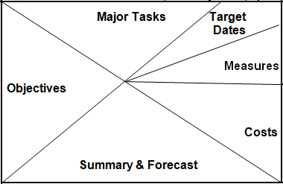
3. Check the ‘matrix’.
This is about not making assumptions!

Slide 18
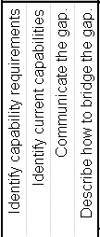
4. Add 3-4 sub-objectives.
Discriminate by ‘importance’!

Slide 19
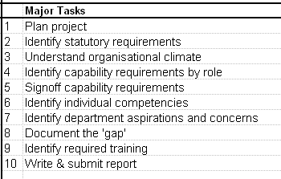
5. Name the major
project tasks.
Again, discriminate by ‘importance’!

Slide 20
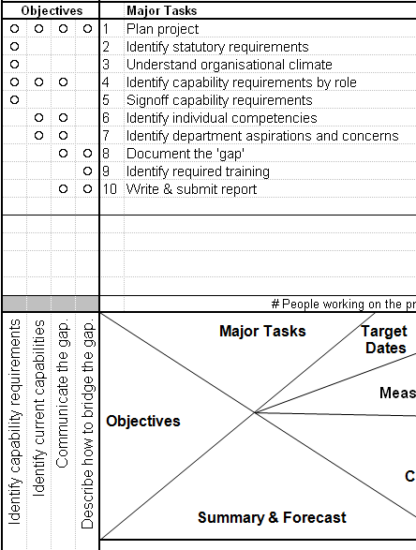
6. Link tasks with sub-objectives (using dots).
Can’t make a link? Throw something out!

Slide 21

7. Create a timeline.
Days, weeks, fortnights, months, quarters?

Slide 22
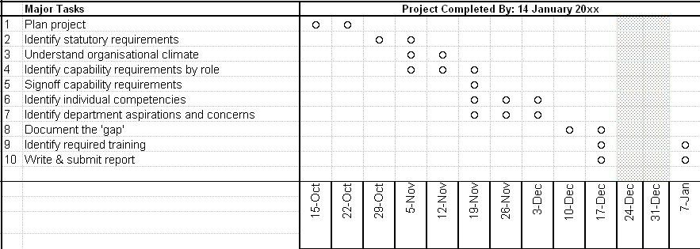
8. Link tasks with time
(using dots).
This is rough, and thus a great way to keep it simple!

Slide 23
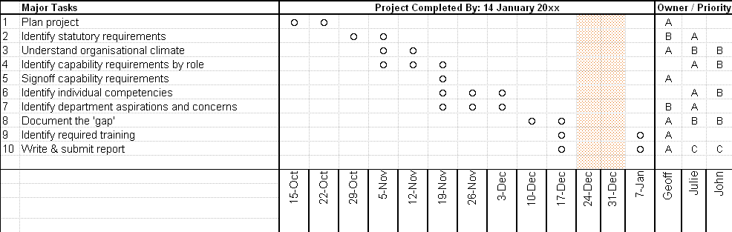
9. Link tasks with owners (using ABC priorities).
Try to have a single A owner; use dots on simple projects!

Slide 24

9a. Add a ‘people count’ (optional).
Only do this if it is useful!

Slide 25

10. Add quantitative or qualitative measures.
Use measures that are meaningful to the client!
(The approach here is different to The One Page
Project Manager book and the standard template.)

Slide 26
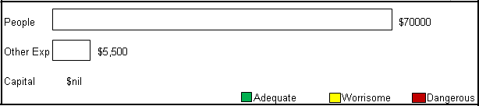
11. Add project budget.
Ensure that the empty bars are of roughly proportional length.
(The colour codes are for later.)
(This approach is from The One Page Project Manager
book, and involves changes to the standard template.)

Slide 27
Flexibility
Don’t be afraid to make changes – continuous improvement is about taking advantage of opportunities and overcoming obstacles.
When this happens, and it impacts the OPPM, change it!

Slide 28

HAVE A GO YOURSELF!!!
To Download the Excel File, : one page project manager resources
& download OPPM Template

Slide 29
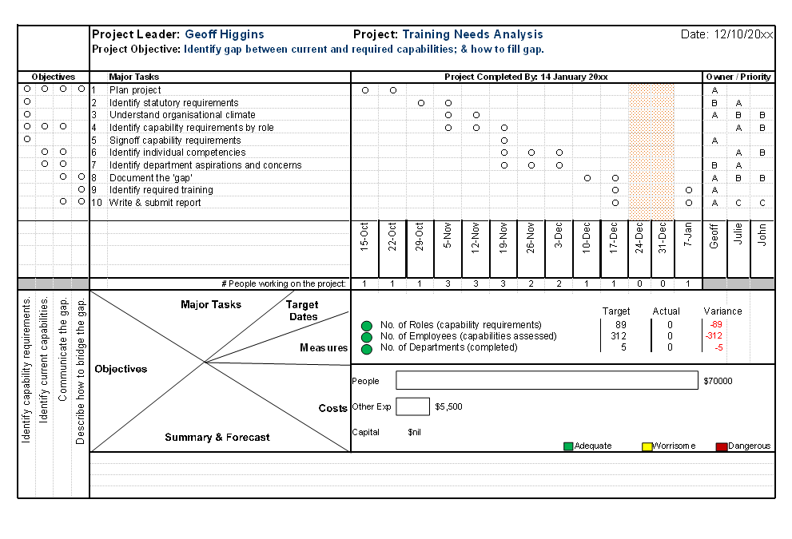
Sample Project Plan – Showing the Project Plan

Slide 30


Slide 31
General Principles
Always work on the OPPM with the team/team leaders
Get task owner agreement to changes to commitments in the OPPM
This is the time to identify and discuss issues and opportunities
Do a ‘Save As…’ before making changes!

Slide 32
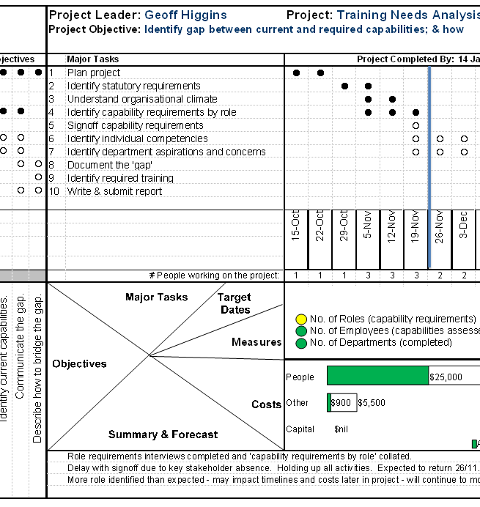






Update Details
0. Bring the team/team leaders together.
Shift ‘current date’ line to the right.
Fill in progress dots.
Update product progress.
Update costs.
Fill in ‘summary & forecast’.
2a
2b
1
3
4
5
Adapted from: Campbell 2007, fig 6.2

Slide 33
0. Bring the team/team leaders together.
(‘All Hands Meeting ’ c/o www.handsonusa.org )
Every single time!
(‘Meeting Outside’ c/o www.cexp.com/officenow)
Photos courtesy of www.flickr.com.
(Under creative commons license.)

Slide 34
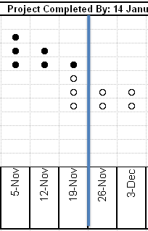
1. Shift ‘current date’
line to the right.

Slide 35
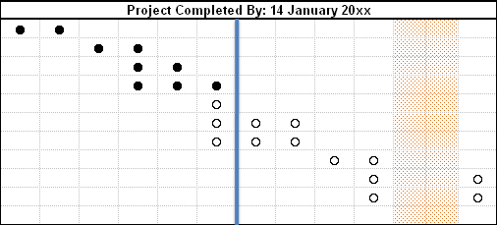

2a. Fill in progress dots.

Slide 36
2a. Fill in progress dots.
Filled in dots mean progress
Empty to left = ‘fallen behind’
Filled to right = ‘ahead of plan’

Slide 37
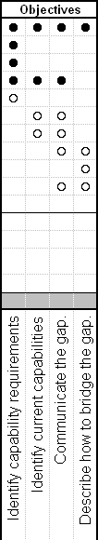
2b. Fill in more progress dots.

Slide 38

3. Update product progress.
You need to decide what the colour codes mean – for example, is it about progress or confidence.
  Green On Time Confident we are OK
  Yellow A Little Behind Not so confident
  Red Way Behind Confident we are not OK
(Example using the ‘measures’ template.)

Slide 39
3. Update product progress.
Be really honest – as you cannot ‘take away’ progress
in a subsequent reporting period!
(Example using the ‘measures’ template.)

Slide 40
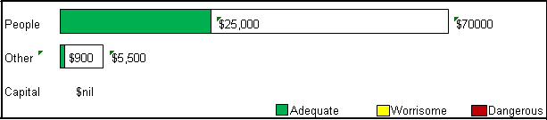
4. Update costs.
Budget colour codes are based on your forecast:
  Green good (>5% below budget)
  Yellow not so good (within 5% of budget)
  Red bad (>5% over budget)
(This approach is from The One Page Project Manager
book, and involves changes to the standard template.)

Slide 41
4. Update costs.
Again, be honest & accurate – as you cannot ‘take away’ progress
in a subsequent reporting period!
(This approach is from The One Page Project Manager
book, and involves changes to the standard template.)

Slide 42
5. Fill in ‘summary & forecast’.
Looking back, describe ‘how the project is going’ in your words.
Looking forward, describe what is coming up.
Describe major milestones, risks, issues, and opportunities.
Explain all red content.

Slide 43
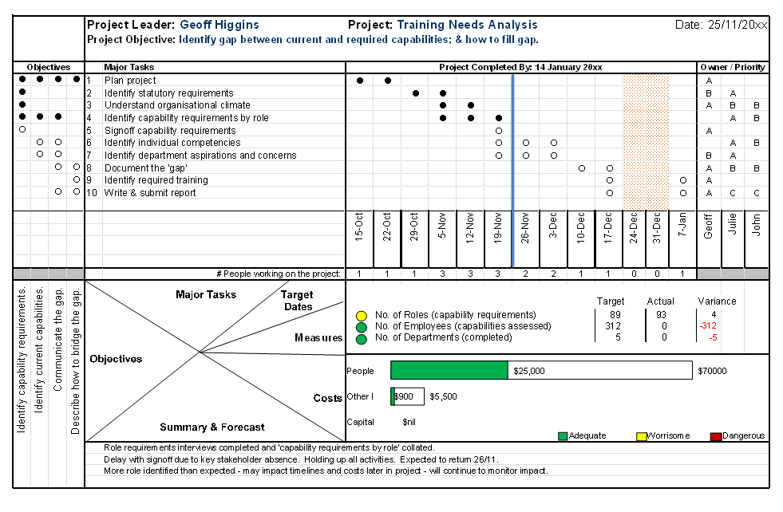
Sample Project Plan – Showing Project Progress

Slide 44
Reading & Resources
Campbell, CA 2007 The One-Page Project Manager Wiley & Sons, New Jersey.
Campbell’s Resources at www.onepageprojectmanager.com/oppm/resource.html
Balanced customer review on Amazon.com
http://www.amazon.com/review/R1M1BI11AF4D7N

Slide 45
© Performance People Pty Ltd, 2009
The One Page Project Manager is the
property of O.C.Tanner Co.
Photos courtesy of www.flickr.com.
(Under creative commons license.)
Added to SlideShare by GeoffatPerformancePeople

